Slide 1
Mid Semester Progress
Sai Lavanya Puthila
Zach Edwards

Slide 2
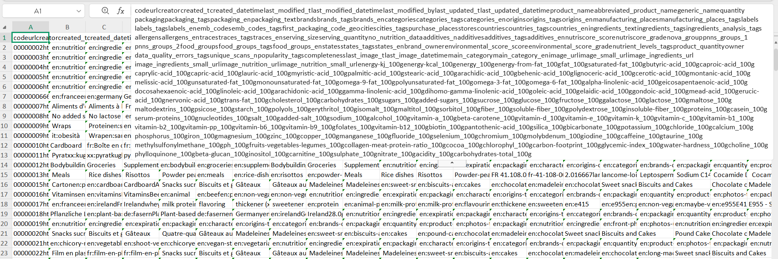
Brief Overview of The Dataset

Slide 3
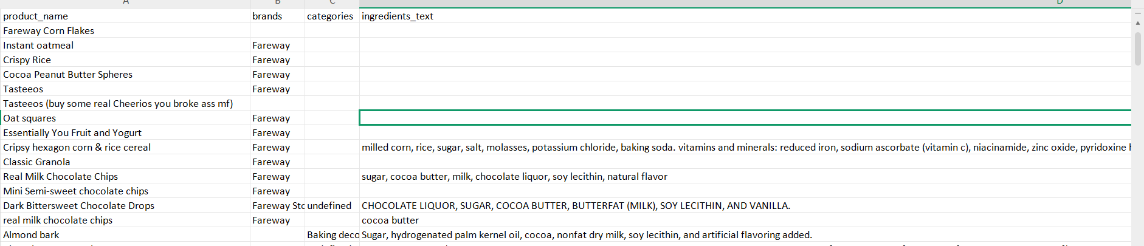

Slide 4
The Additives List
Created a list of harmful additives that could be ingredients
Risk score is how many additives are in a product
Ex: 'maltodextrin','monosodium glutamate','citric acid','yellow 6'

Slide 5
The Models Trained
Logistic Regression
Linear Discriminant Analysis (LDA)
K-Nearest Neighbors (KNN)
Random Forest
Logistic Regression: 1.00
LDA: 0.998
KNN: 0.999
Random Forest: 1.00

Slide 6
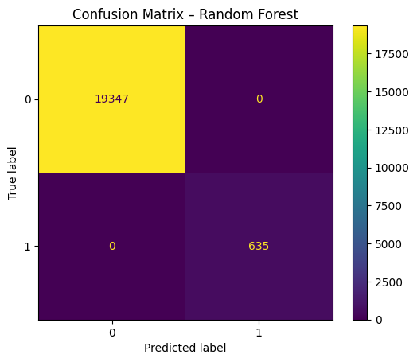
Confusion Maxtirx
Almost Perfect

Slide 7
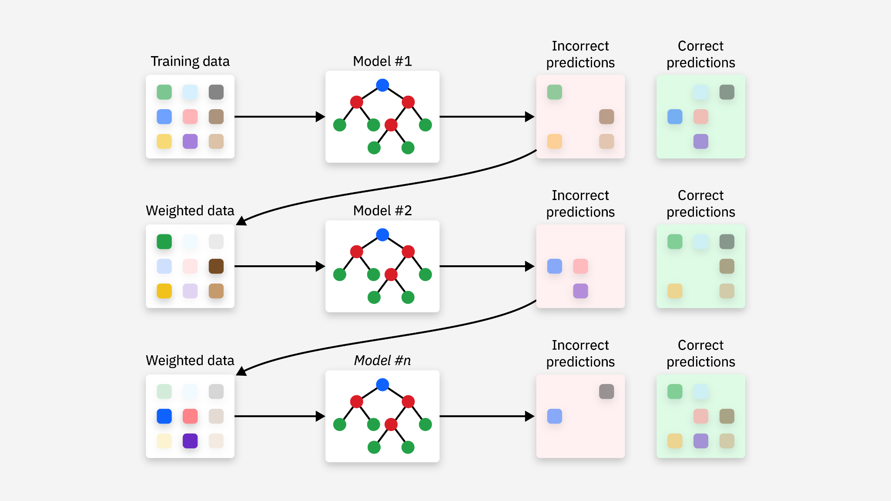
The Best Overall Model
Gradient Boosting Model (.91)
Strong at predicting more advanced relationships

Slide 8
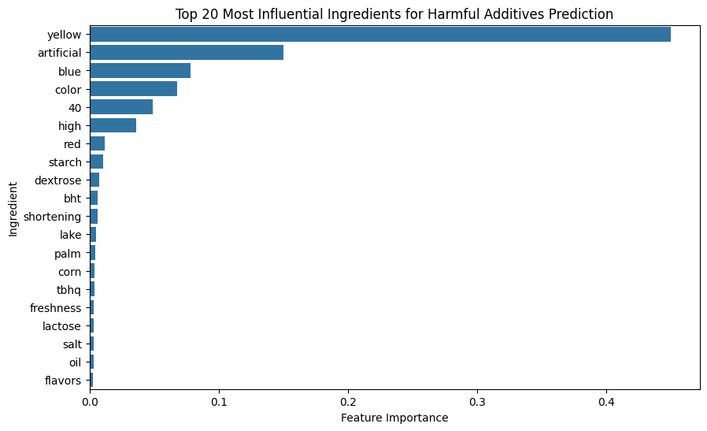
Additives that can predictive other additives

Slide 9
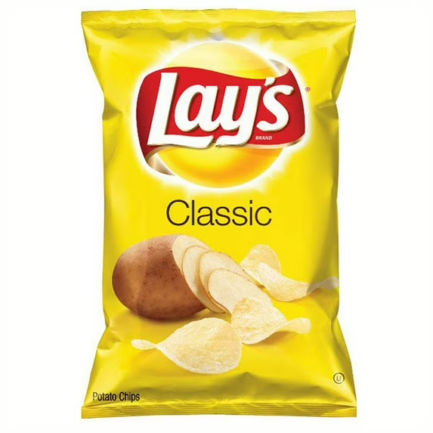
How The Models will be Used to Solve the Problem and How they can be advanced upon
More additives will be key
Risk score
Structuring the models

